Slide 1



Customer Feedback Analysis and Improvement
DEPI
A Comprehensive Sentiment Analysis and Data Processing Solution

Slide 2
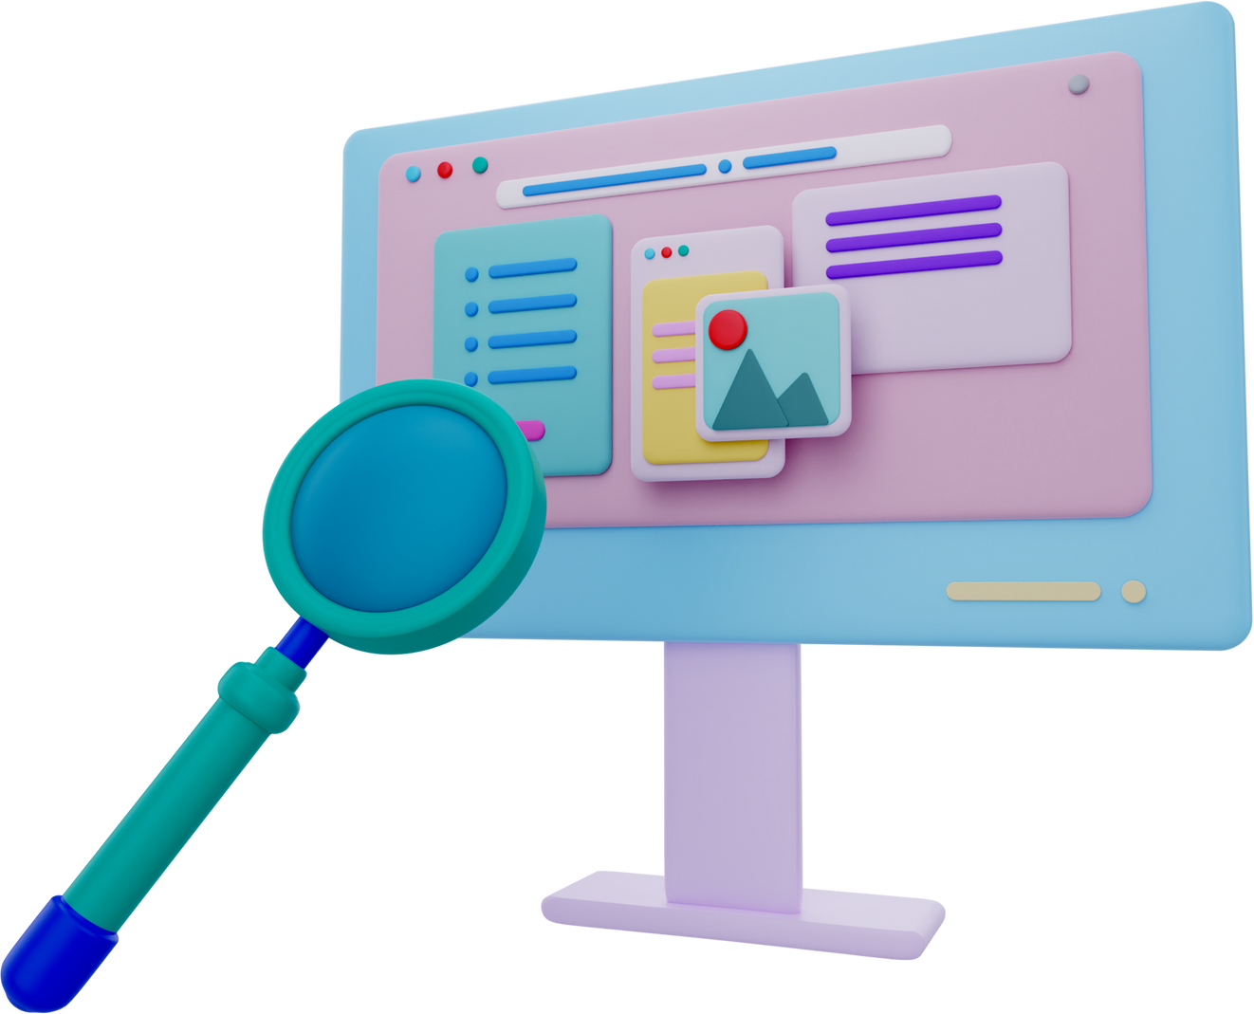
Introduction
Objective: To analyze customer feedback, classify sentiments, and improve customer experience through data-driven insights.
Agenda:
SQL Database Design and Setup
Data Warehouse and Processing
Sentiment Analysis and Azure Integration
MLOps and Deployment

Slide 3



Week 1 - SQL Database Setup and Data Collection
DATABASE DESIGN
DATA COLLECTION
SQL
QUERIES

Slide 4
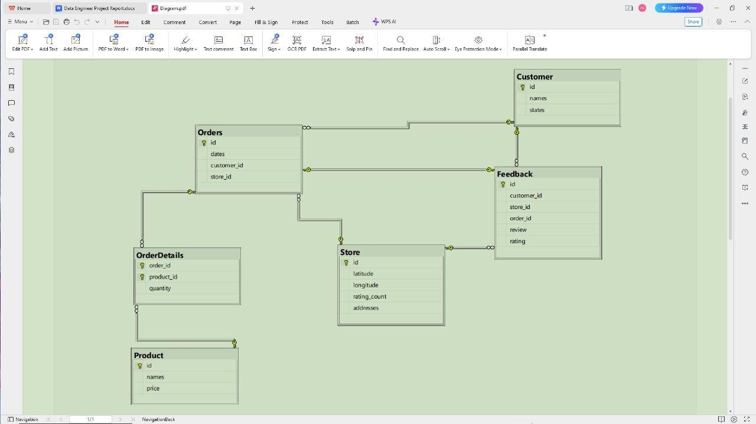

Database Schema Diagram

Slide 5
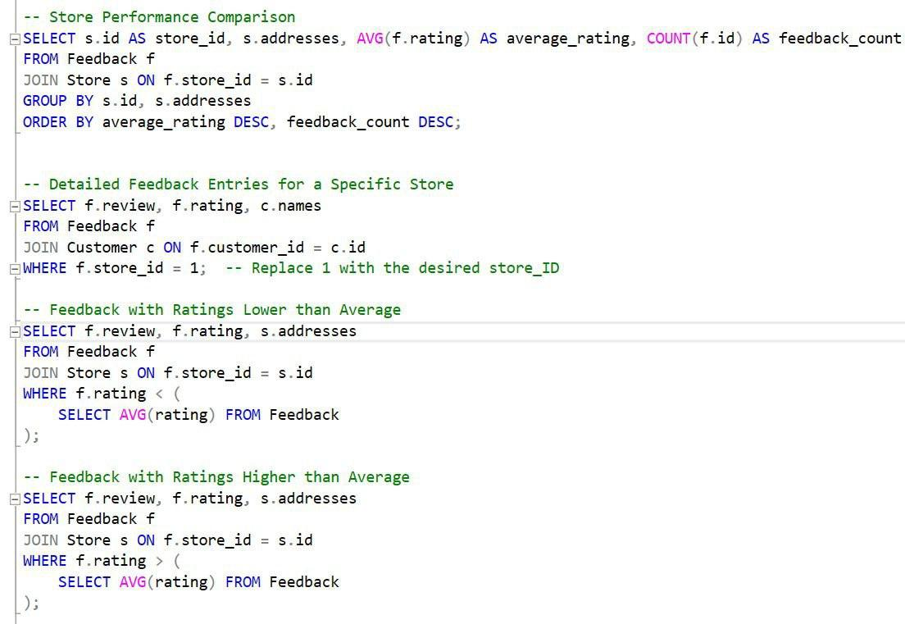
SQL Queries for Feedback Extraction

Slide 6



Week 2 - Data Warehouse and Python Processing
DATA WAREHOUSE IMPLEMENTATION
DATA INTEGRATION
PYTHON PROCESSING

Slide 7
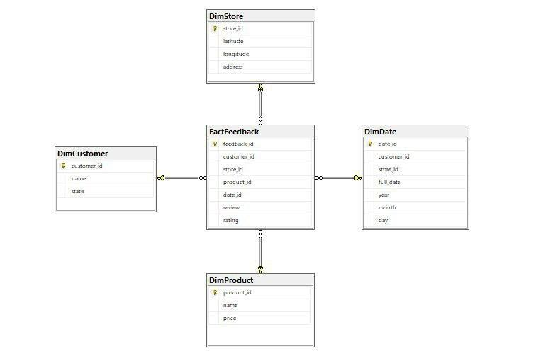

Data warehouse star schema

Slide 8
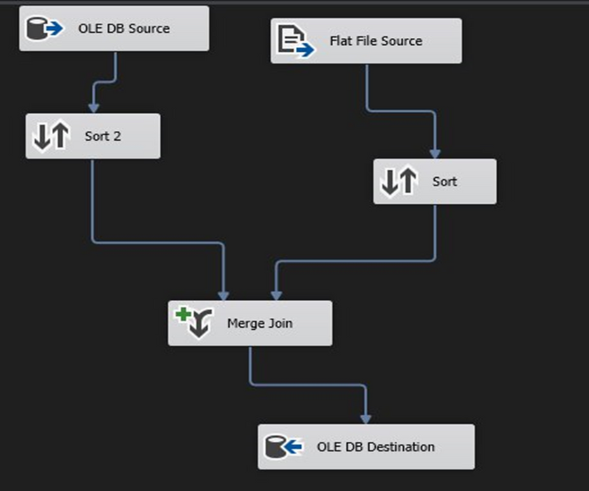
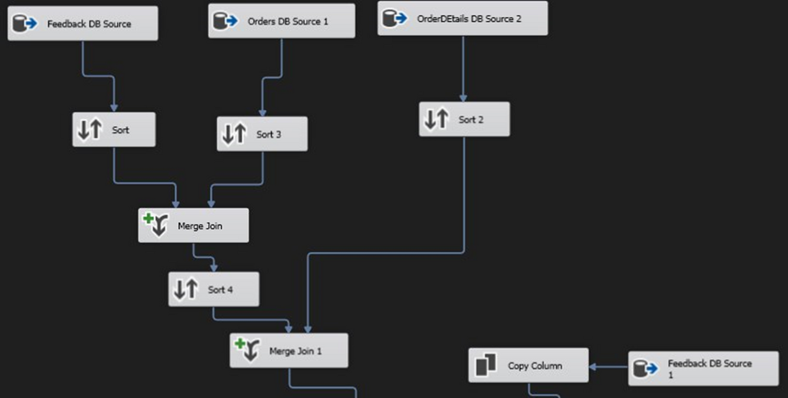
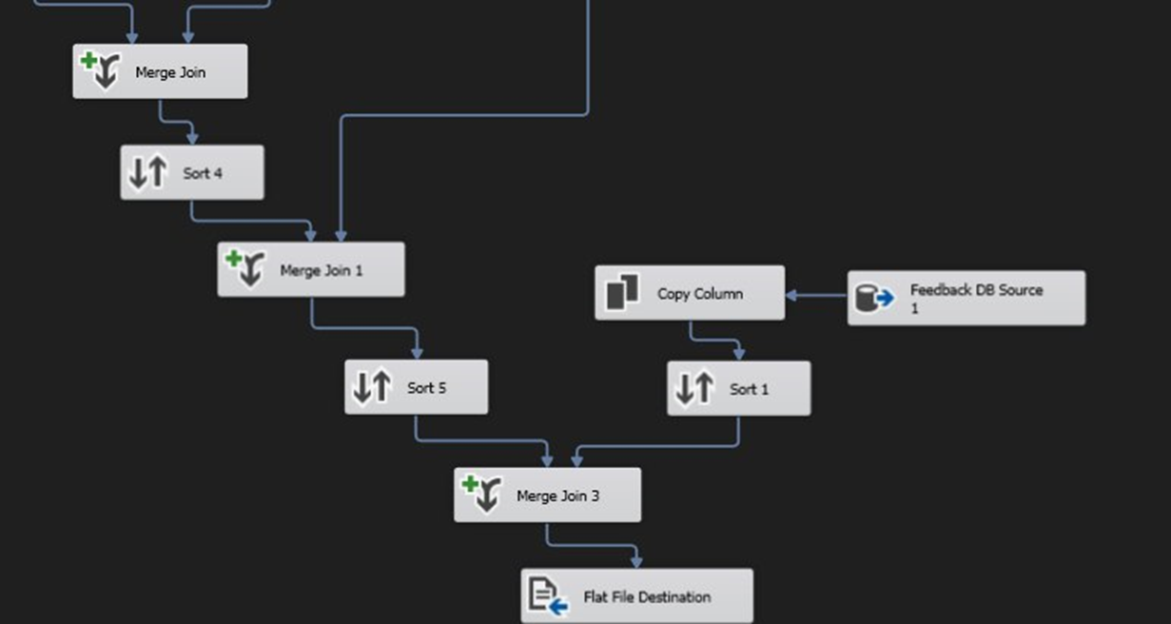
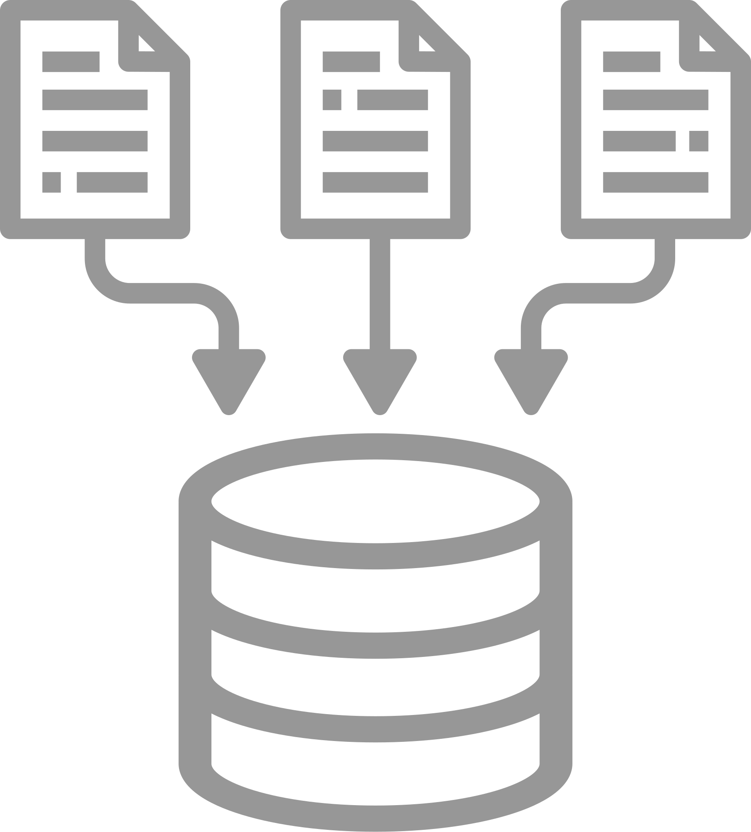
Data Integration

Slide 9
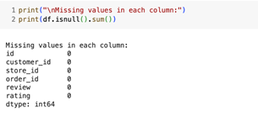
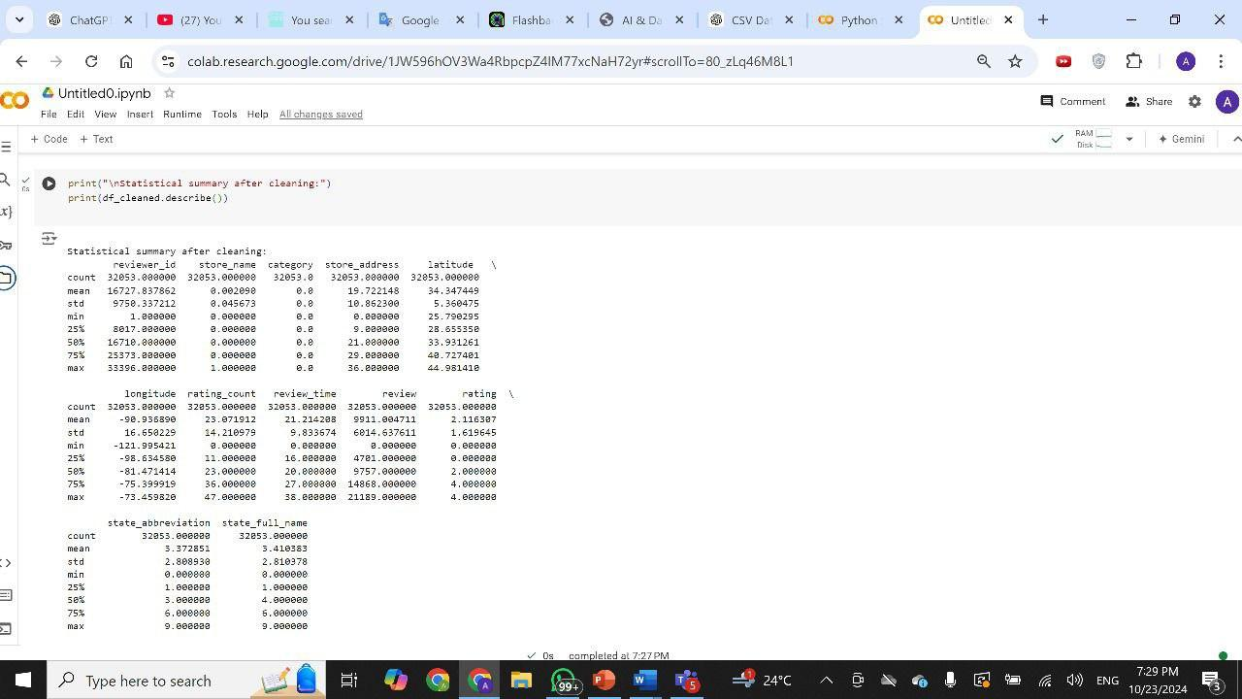
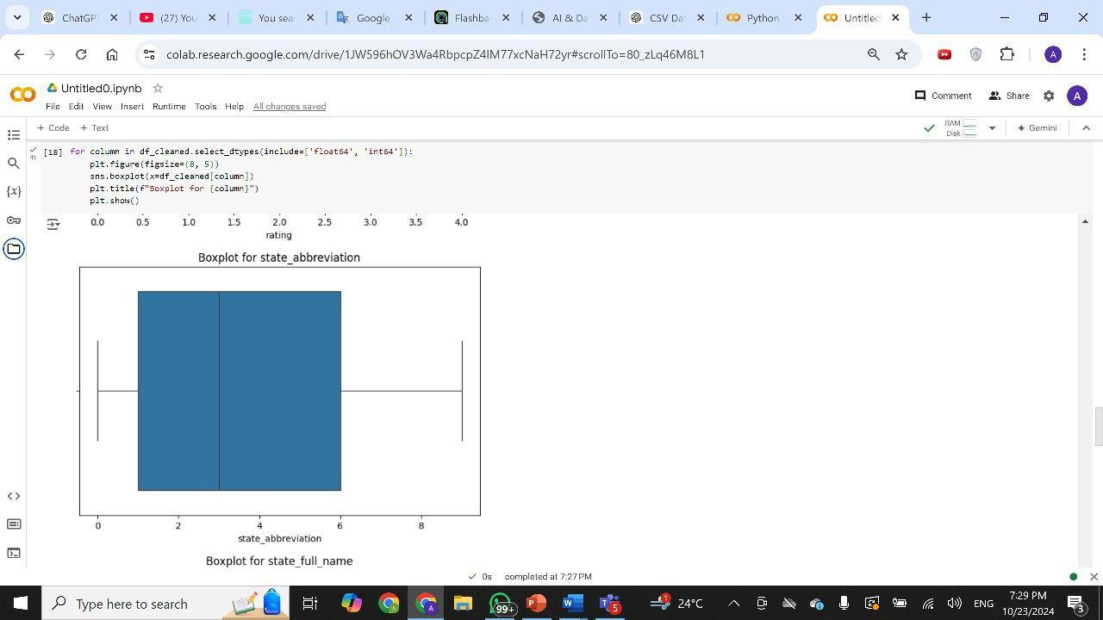

Data Preprocessing

Slide 10

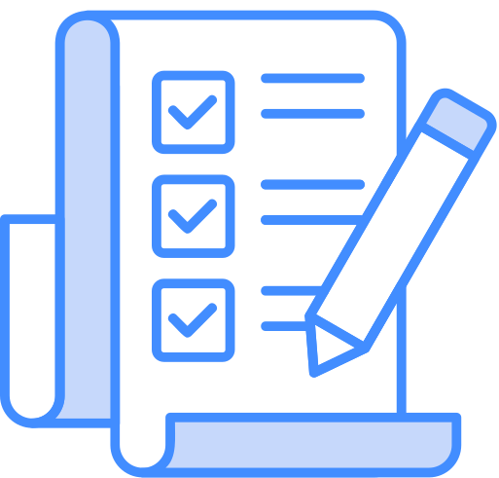
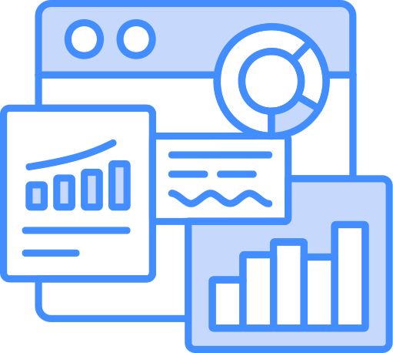
Week 3 - Sentiment Analysis and Azure Integration
SENTIMENT ANALYSIS USING PYTHON
AZURE INTEGRATION FOR STORAGE AND ANALYSIS
MODEL EVALUATION

Slide 11


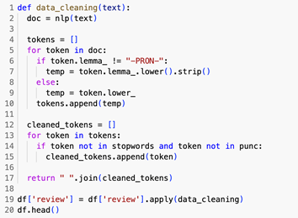
Data Cleaning

Slide 12
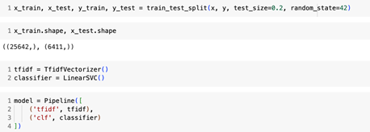
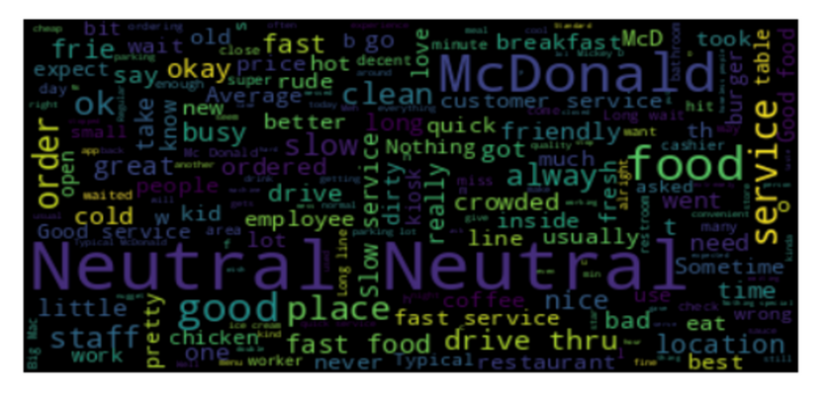
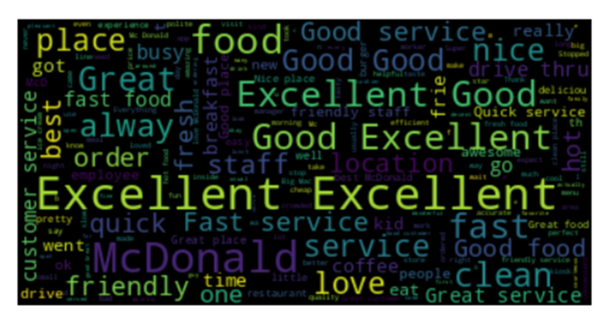
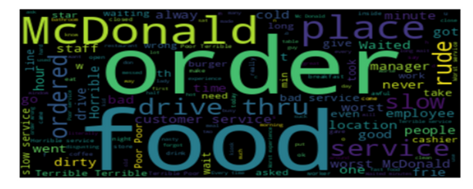
Sentiment Analysis

Slide 13
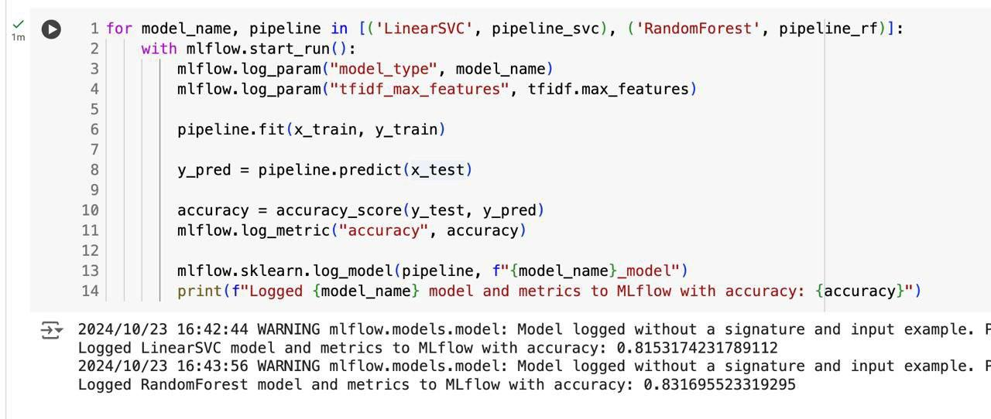

Slide 14
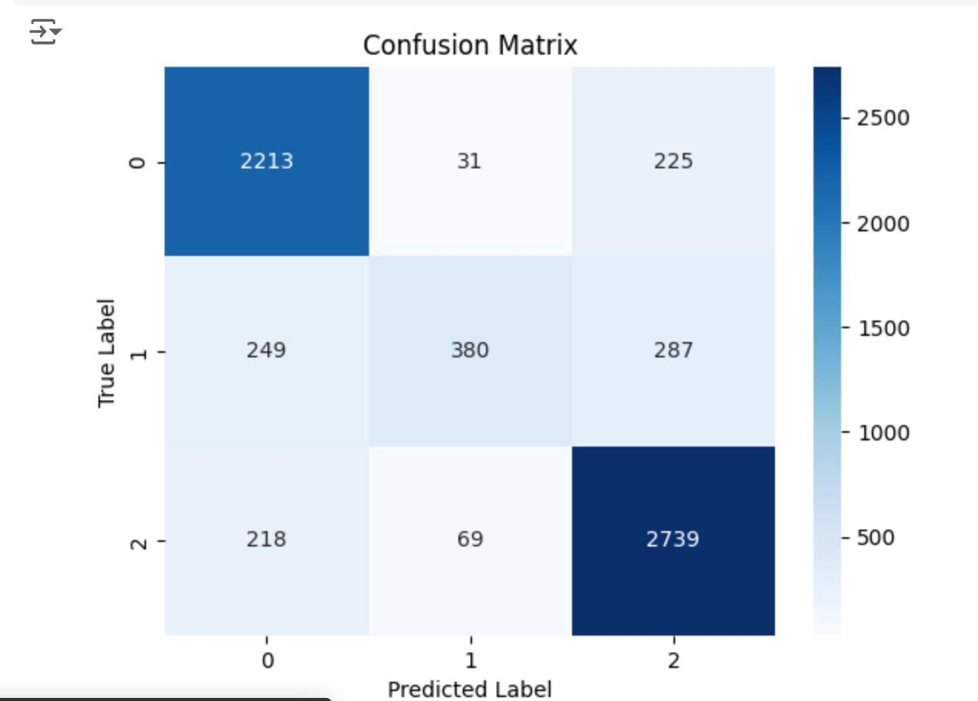

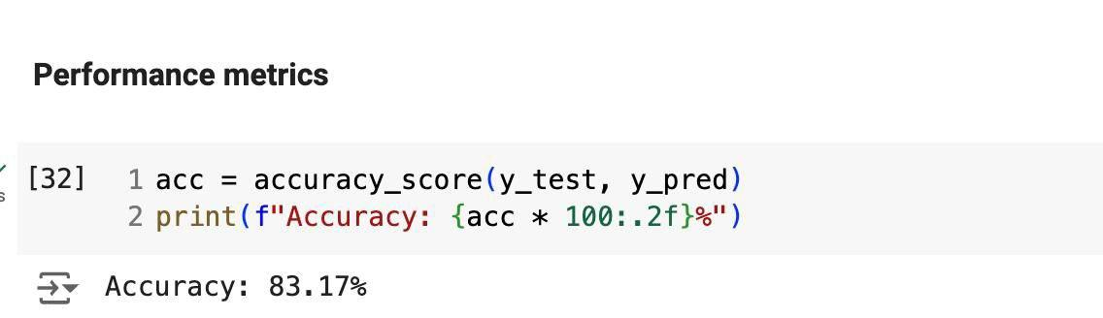
Model Evaluation Results

Slide 15

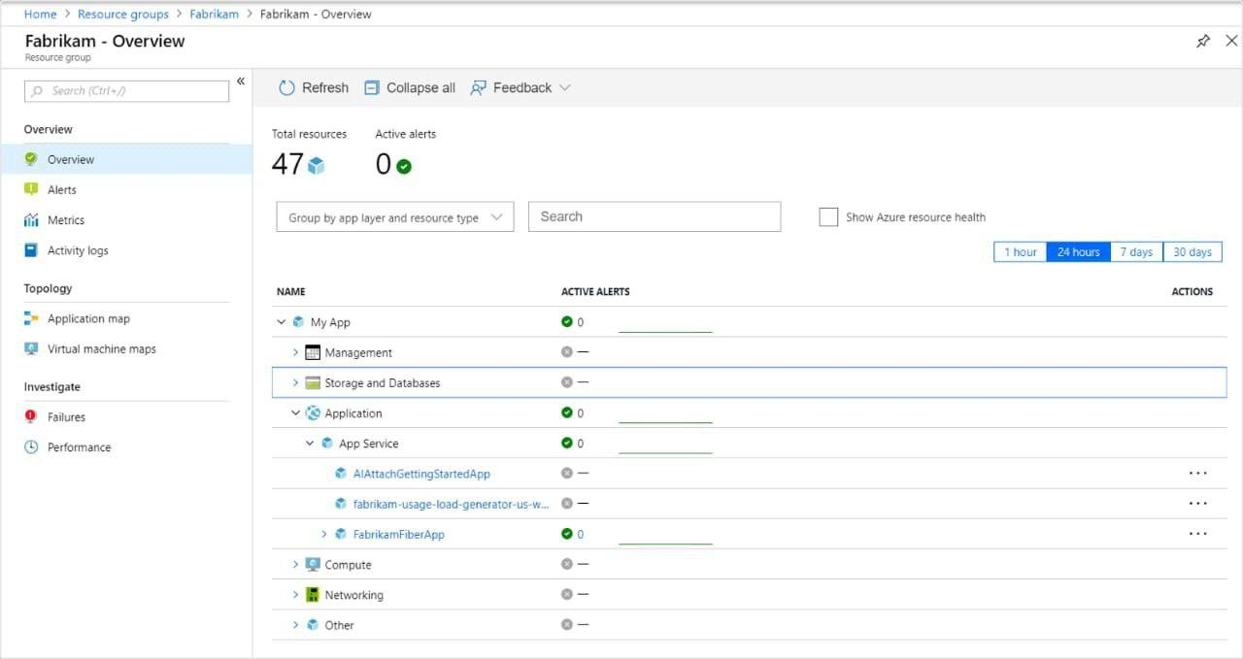
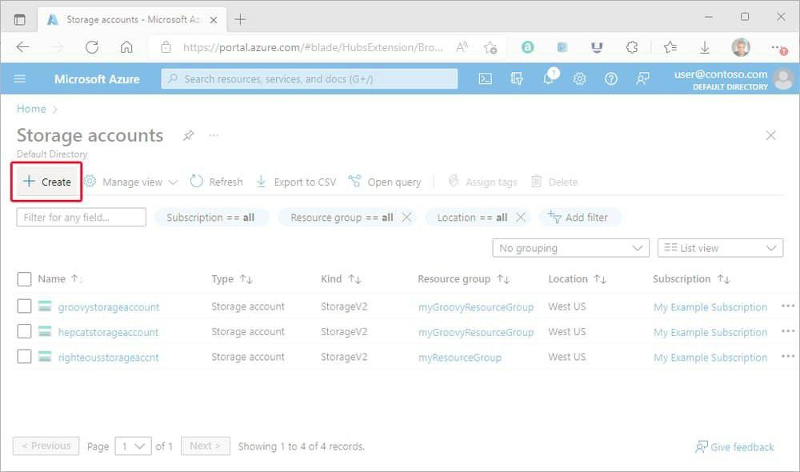
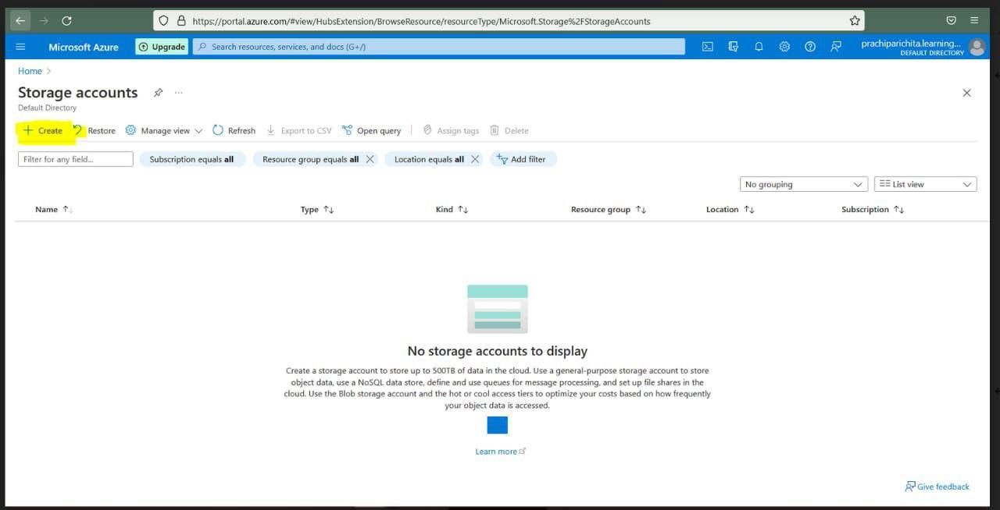
Azure Integration for storage and analysis

Slide 16


Week 4 - MLOps and Deployment
MLOPS WITH MLFLOW
DEPLOYMENT

Slide 17
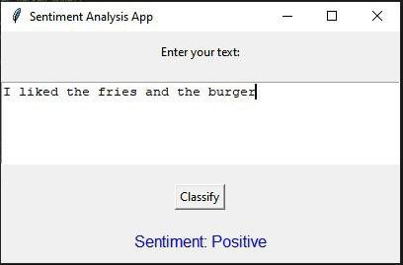
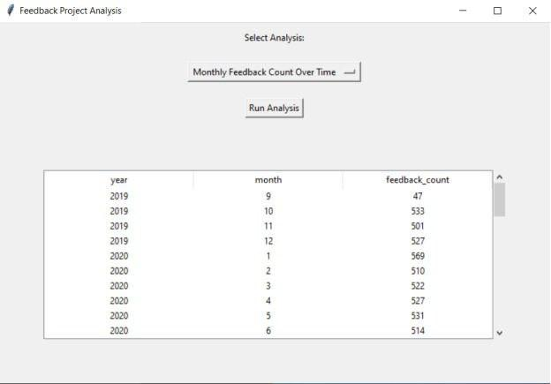
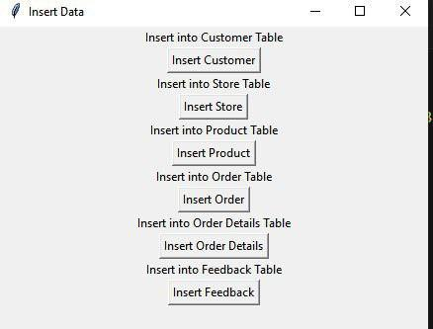
Deployment and Visualization

Slide 18

Any Question?

Slide 19
Thank You!
Presented by:
Hagar Ali Hamed Foda
Aya Abdelsamad
Ahmed Ghareeb
Ahmed Hossam
Pierre Mousa
Esraa Zakaria

Slide 20
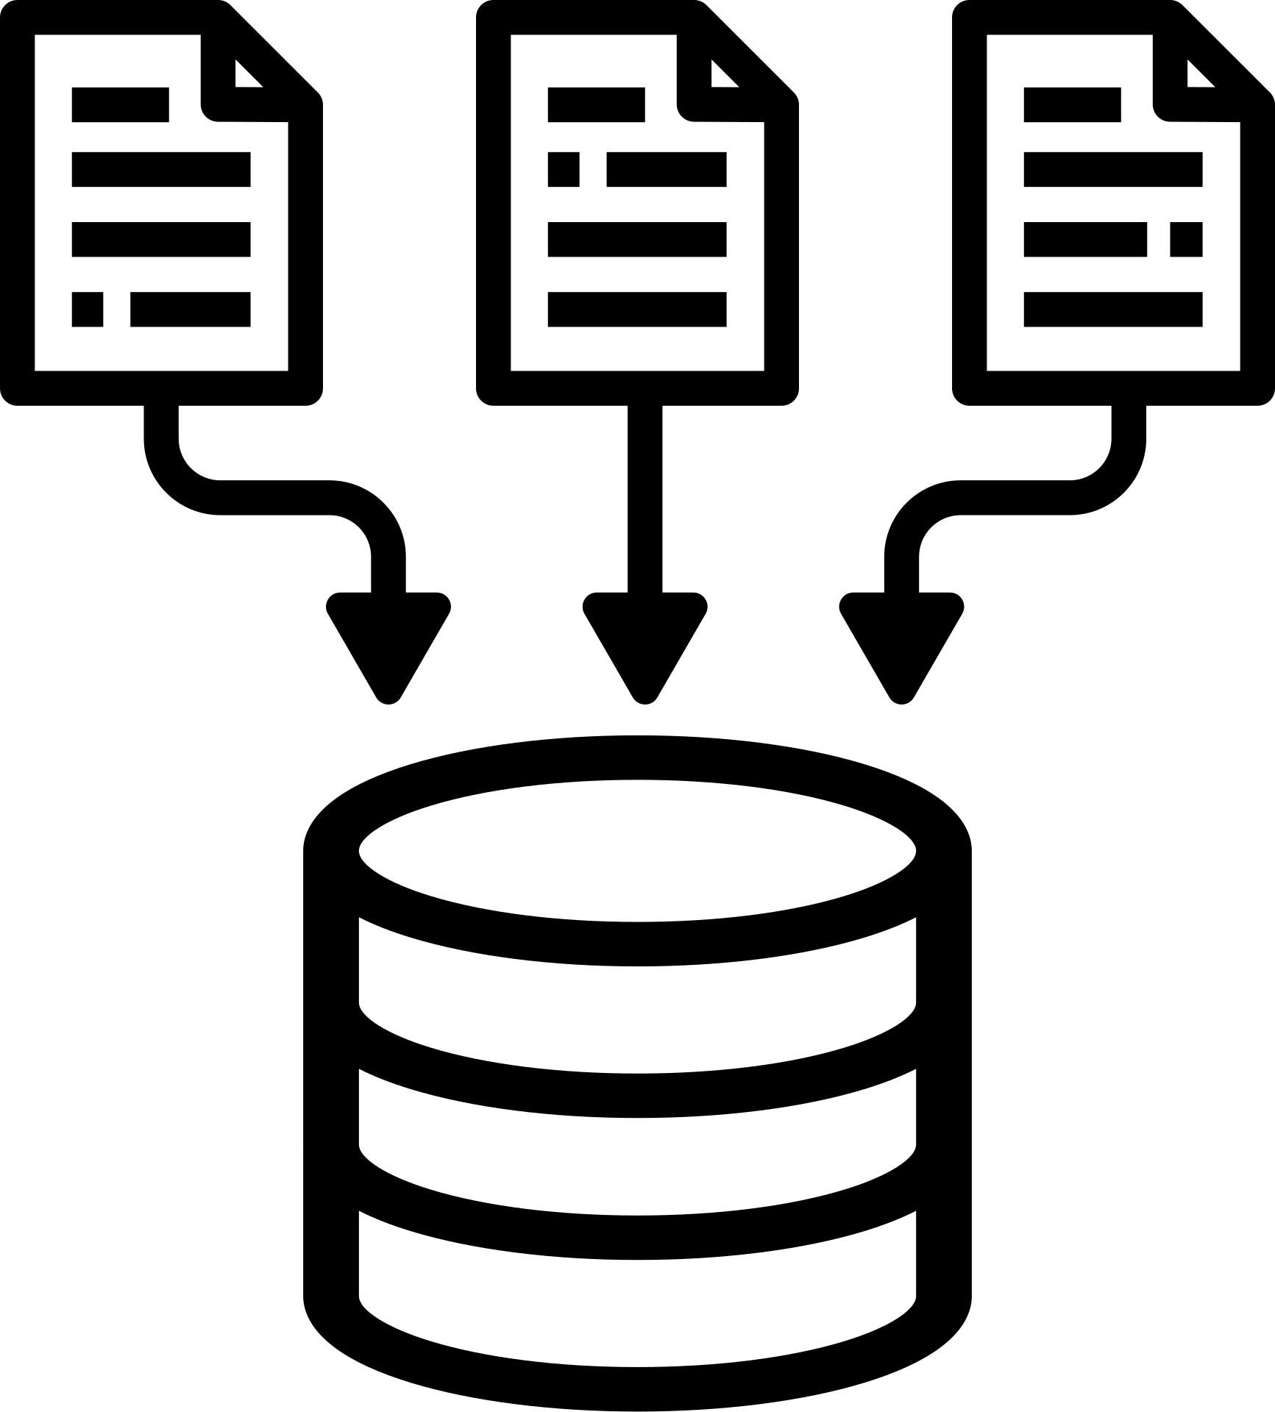
02
Introduction
Objective: To analyze customer feedback, classify sentiments, and improve customer experience through data-driven insights.
Agenda:
SQL Database Design and Setup
Data Warehouse and Processing
Sentiment Analysis and Azure Integration
MLOps and Deployment

